Slide 1
Image Recognition
Using Neural Networks
H
4
n
d
_
Handwritten Digit
r
tt
en
Dig
w
1
it
ELC 152.1
Bugnot, Laboguin, Ramirez

Slide 2
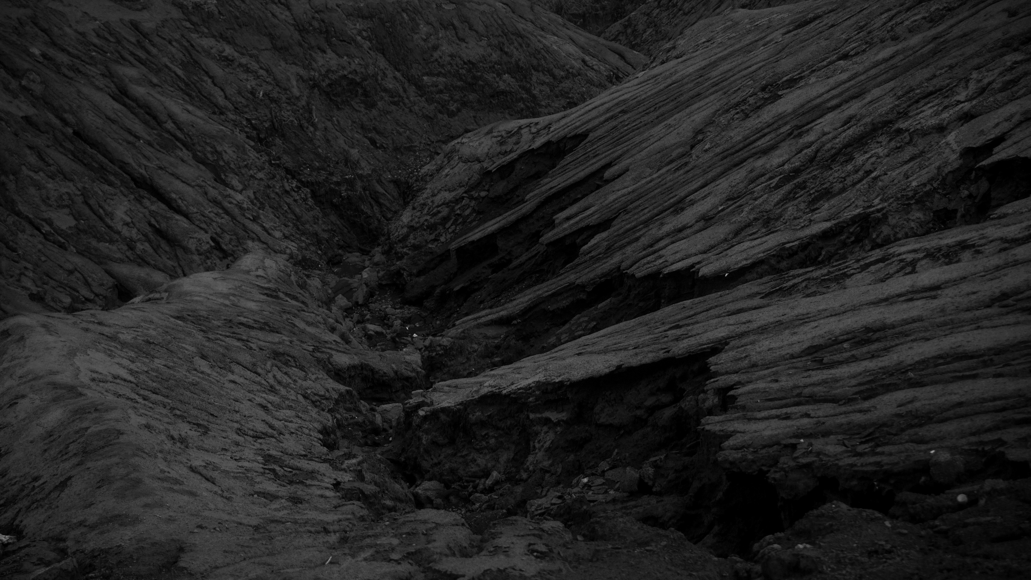
Design the graphical user interface
/0bj3ct1v3s
Pre-process the digital image input
Develop prediction algorithm

Slide 3
/S1gnific4nce
Development of computer-human interface

Slide 4
Use of Feedforward Neural Network
/Sc0p3
Digits only! One at a time
No convoluted features

Slide 5
_
/M3TH0D0L0GY

Slide 6
Upload
Grayscale
Invert
Gaussian
Methodology
GetArray
Unroll
Map
Neural Network

Slide 7
Phase 1: INPUT
4
1
Upload
Upload
RUN

Slide 8
4
Phase 1: INPUT
1
Upload

Slide 9
4
Phase 2: FILTER
Phase 1: INPUT
2
Grayscale

Slide 10
4
Phase 2: FILTER
Phase 1: INPUT
3
Invert

Slide 11
4
Phase 2: FILTER
Phase 1: INPUT
4
Gaussian

Slide 12
Phase 3: DATA PRE-PROCESSING
Phase 1: INPUT
Phase 1: INPUT
0, 0, 0, 0, 0, 0, 0, 0, 0, 0, 0, 0, 3, 0, 1, 4, 1, 0, 0, 0, 0, 0, 0, 0, 0, 0, 0, 0, 0, 0, 0, 0, 4, 0, 0, 1, 6, 9, 0, 0, 0, 0, 0, 0, 0, 0, 0, 0, 0, 0, 0, 0, 0, 1, 2, 1, 0, 2, 0, 0, 0, 0, 0, 0, 0, 0, 0, 0, 0, 0, 0, 0, 5, 0, 0, 2, 10, 14, 0, 0, 0, 0, 0, 0, 0, 0, 0, 0, 0, 0, 0, 0, 0, 0, 1, 1, 0, 0, 0, 0, 0, 0, 0, 0, 0, 0, 0, 0, 0, 0, 0, 0, 2, 7, 4, 0, 4, 12, 0, 0, 0, 2, 0, 2, 13, 7, 1, 0, 17, 70, 52, 4, 9, 9, 0, 2, 0, 0, 13, 0, 0, 0, 13, 9, 8, 0, 0, 0, 0, 0, 0, 5, 1, 5, 1, 0, 46, 249, 252, 253, 250, 5, 6, 0, 2, 8, 0, 14, 0, 228, 238, 16, 34, 222, 53, 9, 2, 5, 0, 193, 245, 1, 0, 3, 13, 1, 255, 163, 0, 0, 0, 3, 139, 143, 0, 10, 8, 5, 236, 255, 0, 2, 3, 0, 0, 160, 158, 0, 0 55, 12, 3, 157, 230, 46, 0. 11. 203, 255, 212, 2, 4, 1, 0, 216, 164, 27, 7, 255, 194, 255, 194, 239, 237, 155, 241, 203, 15, 0, 0, 0, 3, 0, 4, 225, 109, 190, 3, 3, 5, 0, 13, 0, 14, 11, 90, 0, 184, 250, 3, 1, 0, 4, 0, 0, 0, 0, 13, 0, 126, 245, 234, 64, 0, 18, 0, 0, 2, 2, 6, 9, 10, 201, 154, 133, 86, 1, 10, 0, 1, 3, 5, 47, 4, 9, 16, 167, 251, 0, 0, 0, 2, 1, 4, 3, 40, 0, 45, 48, 12, 154, 209, 11, 9, 0, 0, 8, 17, 3, 0, 0, 1, 0, 2, 4, 136, 243, 0, 5, 1, 0, 0, 1, 7, 4, 0, 3, 2, 2, 0, 154, 209, 7, 0, 13, 0, 0, 4, 6, 9, 8, 0, 0, 5, 0, 0, 0, 4, 2, 3, 12, 10, 0, 0, 0, 0, 0, 0, 0, 0, 0, 0, 0, 0, 0, 0, 0, 2, 2, 0, 1, 0, 0, 0, 0, 0, 0, 0, 0, 0, 0, 0, 0, 0, 0, 0,
5
Get Array

Slide 13


Phase 3: DATA PRE-PROCESSING
Phase 1: INPUT
Phase 1: INPUT
$$\left[\begin{matrix}a & b & c \\ d & e & f \\ g & h & i\end{matrix}\right]$$
6
Unroll
$$\left[\begin{matrix}a & b & c & ⋯ & h & i\end{matrix}\right]$$

Slide 14
0, 0, 0, 3, 0, 1, 4, 1, 254

Slide 15
Phase 3: DATA PRE-PROCESSING
Phase 1: INPUT
Phase 1: INPUT
7
Values from 0 to 255
Map
Values from -0.15 to 1.10

Slide 16
-0.15, -0.15, -0.15, -0.11, -0.15, -0.14, -0.11, -0.15, 1.1

Slide 17

8
Neural Net
Neural Network
Input[1][401]
PREDICTION!
Theta1[401][25]
Theta2[26][10]
The Sigmoid Function

Slide 18
8
Neural Net
Neural Network
Input[1][401]
PREDICTION!
Theta1[401][25]
Theta2[26][10]
The Sigmoid Function

Slide 19
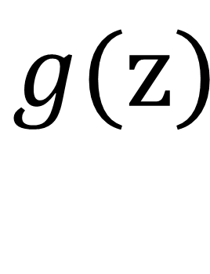
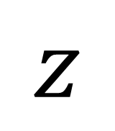

$$z$$
$$g()$$
$$g(z)$$

Slide 20
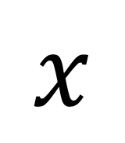
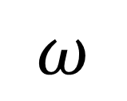
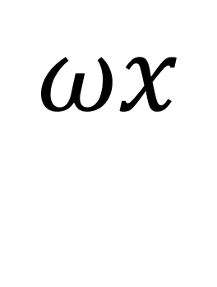
$$ω$$
$$x$$
$$ωx$$

Slide 21
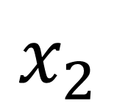
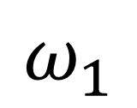
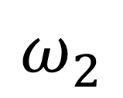

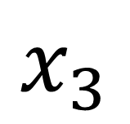
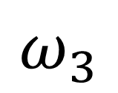
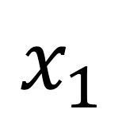
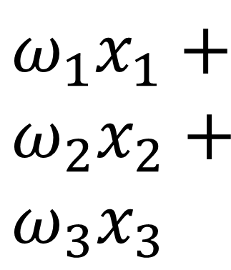
$$x_{1}$$
$$ω_{1}$$
${ω_{1}x}_{1}+$ ${ω_{2}x}_{2}+$
$${ω_{3}x}_{3}$$
$$ω_{2}$$
$$x_{2}$$
$$ω_{3}$$
$$x_{3}$$

Slide 22
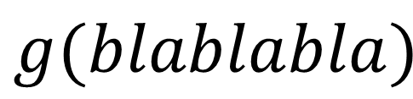
$$x_{1}$$
$$ω_{1}$$
$$ω_{2}$$
$$g()$$
$$x_{2}$$
$$g(blablabla)$$
$$ω_{3}$$
$$x_{3}$$

Slide 23
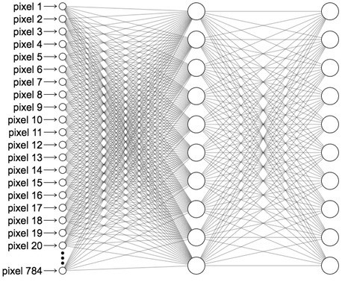
Input layer
hidden layer
output layer

Slide 24
1
2
3
4
…

Slide 25
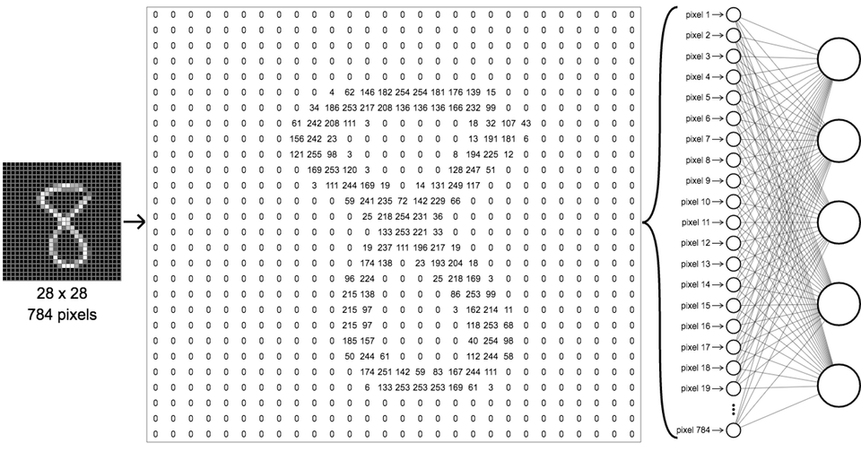

Slide 26
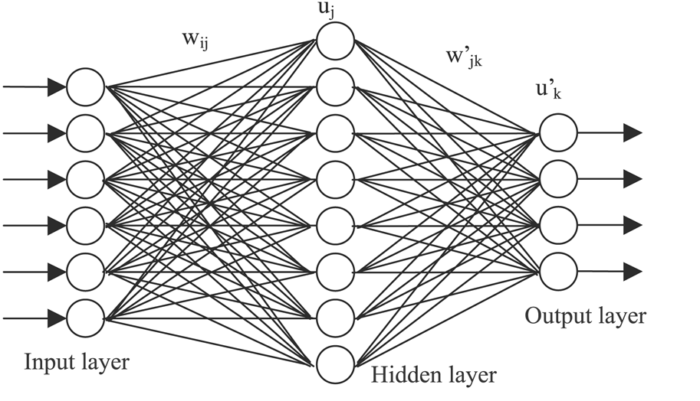
…
…
8
0.013
= 5
0.051
= 6
0.124
= 7
0.989
= 8
…
…

Slide 27
_
/PR0J3CT D3M0

Slide 28
_
/C0NCLUS10N

Slide 29
Prediction Accuracy:
97.6%
calculated in a separate software (MATLAB)

Slide 30
Limitations:
1. No Resampling Algorithm
Example: Bicubic Interpolation Algorithm <- is a DSP project on its own!
2. Light Background only
No algorithm to detect when not to invert
3. No Auto-cropping

Slide 31
_
/R3C0MM3ND4T10NS

Slide 32
Room for Improvement:
1. No Resampling Algorithm
= Accept Larger Images
2. Light Background only
= No Contrast Restrictions
3. No Auto-cropping
= Read Multi-digit Numbers

Slide 33
/3ND
_

